Slide 1
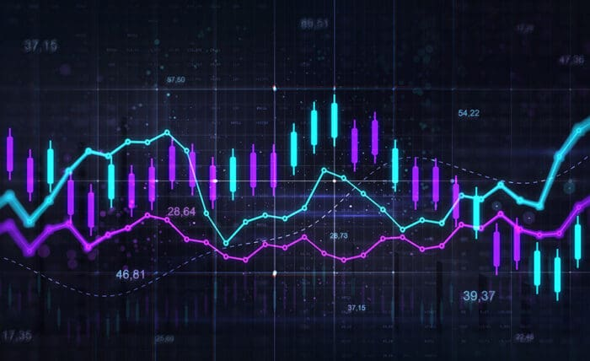
Moments of Distribution, Skewness, and Kurtosis
Understanding the shape of data through statistical moments

Slide 2
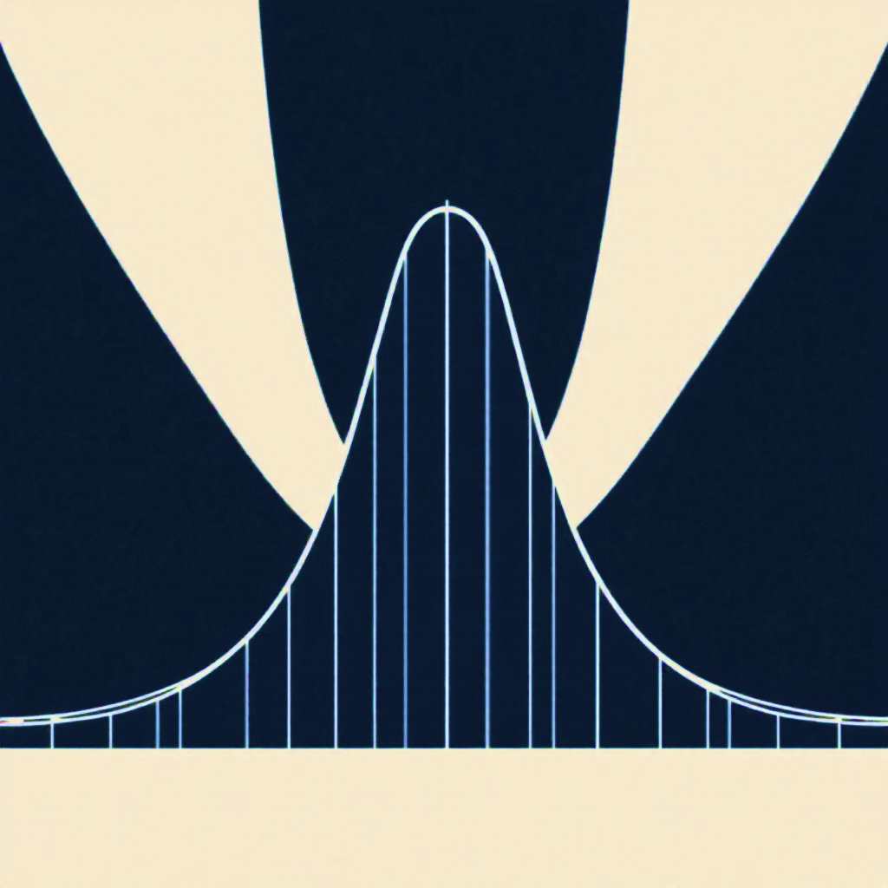







Meet Our Team
Mohammad Aman Ullah
Md Irfan Islam
Abdur Rahim
Mahadi Hasan Fardin
ID: 12409004
ID: 12409015
ID: 12409024
ID: 12409034
Mahmuda Akter Mukta
Md. Nisahdul Islam
Anunnya Paul
ID: 12409043
ID: 12409052
ID: 12409008

Slide 3
Distribution
How data values are spread across possible outcomes.
Usages of Distribution in Statistics
Summarize and describe data
Calculate probabilities of outcomes
Form basis for hypothesis testing
Model real-world events (e.g., accidents, stock returns)
Support decision making in finance, research, and quality control

Slide 4
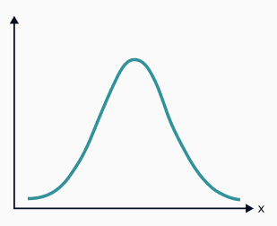
Moments
Moments are numbers that describe the shape of a distribution. They tell us about the center, spread, symmetry, and peakedness of data.
Zero skewness (symmetric)
1st Moment: Mean
2nd Moment: Varience
The distribution is perfectly balanced around the center, like a normal distribution. The mean equals the median.
Shows the center or average of your data
Measures how spread out the data is
Bell shaped curve.
Mean = Median = Mode.
Skewness = 0
3rd Moment: Skewness
4th Moment: Kurtosis
Reveals if data leans left or right
Describes how sharp or flat the peak is

Slide 5
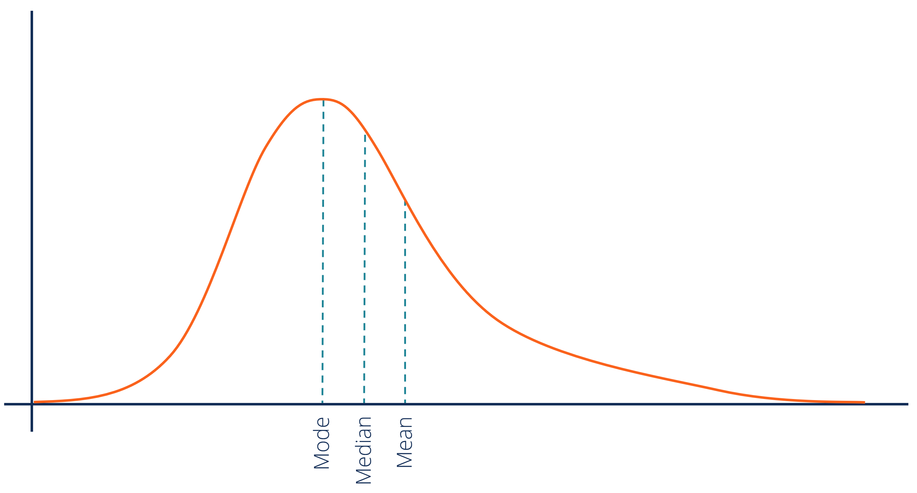
Skewness
Skewness is a statistical measure that describes the asymmetry of a probability distribution or dataset around its mean. It tells us how much the data deviates from a perfectly symmetrical, bell-shaped distribution.
Zero skewness (symmetric)
Positive skewness (right-skewed)
The distribution is perfectly balanced around the center, like a normal distribution. The mean equals the median.
The tail extends more to the right side. Most data points cluster on the left, with fewer high values creating a long right tail. The mean is typically greater than the median
Tail extends right.
Mean > Median.
Few high values
Left-side data clustering
Bell shaped curve.
Mean = Median = Mode.
Skewness = 0

Slide 6
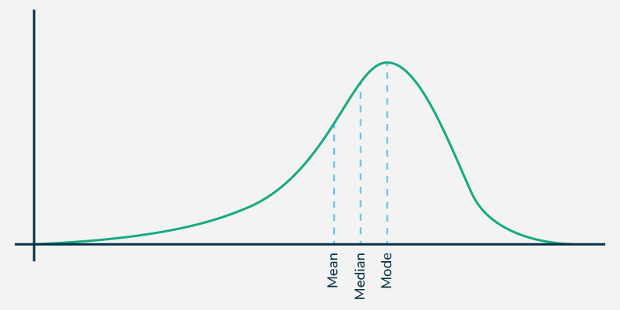
Skewness
Skewness is a statistical measure that describes the asymmetry of a probability distribution or dataset around its mean. It tells us how much the data deviates from a perfectly symmetrical, bell-shaped distribution.
Zero skewness (symmetric)
Positive skewness (right-skewed)
Negative skewness (left-skewed)
The distribution is perfectly balanced around the center, like a normal distribution. The mean equals the median.
The tail extends more to the right side. Most data points cluster on the left, with fewer high values creating a long right tail. The mean is typically greater than the median
The tail extends more to the left side. Most data points cluster on the right, with fewer low values creating a long left tail. The mean is typically less than the median
Bell shaped curve.
Mean = Median = Mode.
Skewness = 0
Tail extends right.
Mean > Median.
Few high values
Left-side data clustering
Tail extends left.
Mean < Median.
Few low values
Right-side data clustering

Slide 7
Skewness
Skewness is a statistical measure that describes the asymmetry of a probability distribution or dataset around its mean. It tells us how much the data deviates from a perfectly symmetrical, bell-shaped distribution.
Positive skewness (right-skewed)
Negative skewness (left-skewed)
Skewness Uses
The tail extends more to the right side. Most data points cluster on the left, with fewer high values creating a long right tail. The mean is typically greater than the median
The tail extends more to the left side. Most data points cluster on the right, with fewer low values creating a long left tail. The mean is typically less than the median
Data distribution assessment
Statistical test selection
Outlier detection
Risk analysis
Performance evaluation
Market research insights
Tail extends right.
Mean > Median.
Few high values
Left-side data clustering
Tail extends left.
Mean < Median.
Few low values
Right-side data clustering

Slide 8
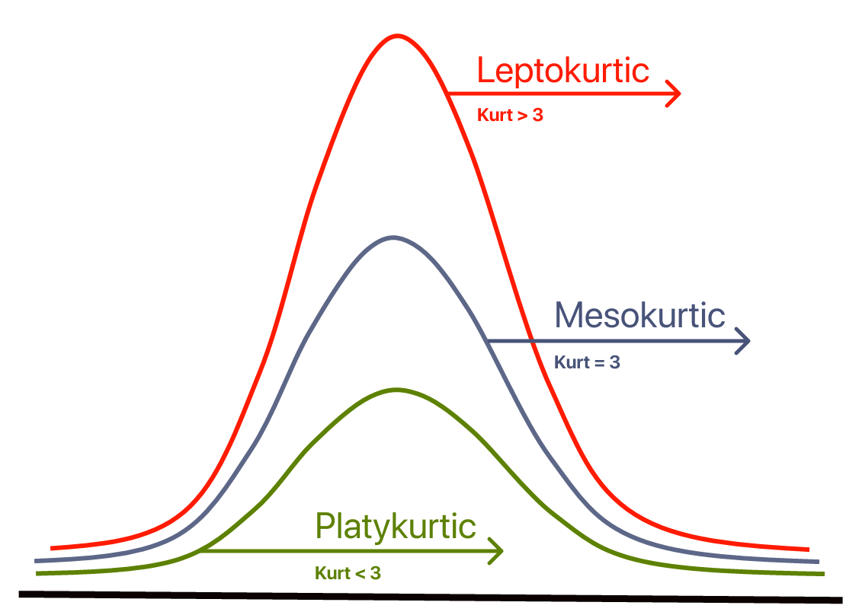
Skewness
Skewness is a statistical measure that describes the asymmetry of a probability distribution or dataset around its mean. It tells us how much the data deviates from a perfectly symmetrical, bell-shaped distribution.
Negative skewness (left-skewed)
Skewness Uses
The tail extends more to the left side. Most data points cluster on the right, with fewer low values creating a long left tail. The mean is typically less than the median
Data distribution assessment
Statistical test selection
Outlier detection
Risk analysis
Performance evaluation
Market research insights
Tail extends left.
Mean < Median.
Few low values
Right-side data clustering

Slide 9
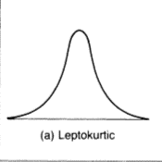
Leptokurtic Distribution (Kurtosis > 3)
Distribution with sharp peak and heavy/thick tails
Tall, sharp peak
Heavy, thick tails
More extreme values
Higher concentration around mean
Positive excess kurtosis
Kurtosis
How much data is concentrated in the tails versus the center of the distribution, and how sharp or flat the peak is

Slide 10
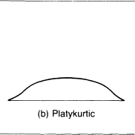
Platykurtic Distribution (Kurtosis < 3)
Distribution with flat peak and light/thin tails
Flat, wide peak
Light, thin tails
Fewer extreme values
More uniform distribution
Negative excess kurtosis
Kurtosis
Leptokurtic Distribution (Kurtosis > 3)
Distribution with sharp peak and heavy/thick tails
Tall, sharp peak
Heavy, thick tails
More extreme values
Higher concentration around mean
Positive excess kurtosis
How much data is concentrated in the tails versus the center of the distribution, and how sharp or flat the peak is

Slide 11
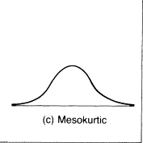
Mesokurtic Distribution (Kurtosis = 3)
Distribution with normal-like tail behavior and peak shape
Normal distribution baseline
Moderate peak height
Standard tail thickness
Balanced extreme values
Excess kurtosis = 0
Kurtosis
Platykurtic Distribution (Kurtosis < 3)
Distribution with flat peak and light/thin tails
Flat, wide peak
Light, thin tails
Fewer extreme values
More uniform distribution
Negative excess kurtosis
Leptokurtic Distribution (Kurtosis > 3)
Distribution with sharp peak and heavy/thick tails
Tall, sharp peak
Heavy, thick tails
More extreme values
Higher concentration around mean
Positive excess kurtosis

Slide 12
Kurtosis
Mesokurtic Distribution (Kurtosis = 3)
Distribution with normal-like tail behavior and peak shape
Normal distribution baseline
Moderate peak height
Standard tail thickness
Balanced extreme values
Excess kurtosis = 0
How much data is concentrated in the tails versus the center of the distribution, and how sharp or flat the peak is
Platykurtic Distribution (Kurtosis < 3)
Distribution with flat peak and light/thin tails
Flat, wide peak
Light, thin tails
Fewer extreme values
More uniform distribution
Negative excess kurtosis

Slide 13
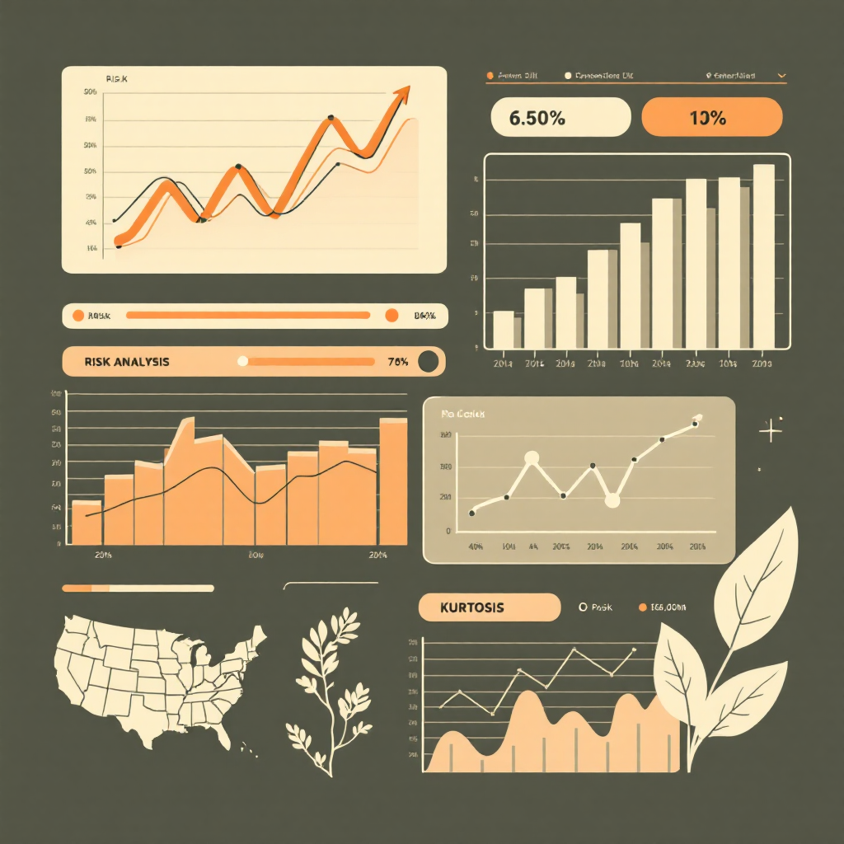
Kurtosis
Practical Uses of Kurtosis
Outlier Detection
High kurtosis indicates more extreme values that might need investigation
Risk Analysis
Financial markets use kurtosis to assess investment risk and volatility
Shape Comparison
Compare different datasets to understand their distributional characteristics
Mesokurtic Distribution (Kurtosis = 3)
Distribution with normal-like tail behavior and peak shape
Normal distribution baseline
Moderate peak height
Standard tail thickness
Balanced extreme values
Excess kurtosis = 0

Slide 14
Thank You
I'm 95% confident you enjoyed this!

